Slide 1

Olympic Data Analysis
By: Andrea Colin, Matthew Sturt, Nick Johanson, and Elizabeth Christian

Slide 2

Dataset
120 years of Olympic history: athletes and results
All the Games from Athens 1896 to Rio 2016
Dataset was obtained from Kaggle
Variables included: ID, Name, Sex, Age, Height, Weight, Team, NOC, Games, Year, Season, City, Sport, Event, Medal

Slide 3
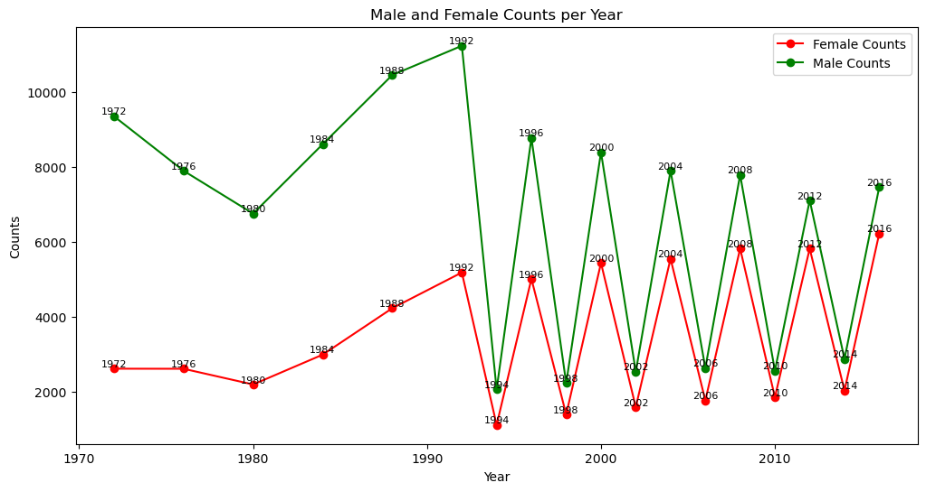
Gender ratios of athletes at Olympic games
Winter and Summer Games were held in the same year up until 1992

Slide 4
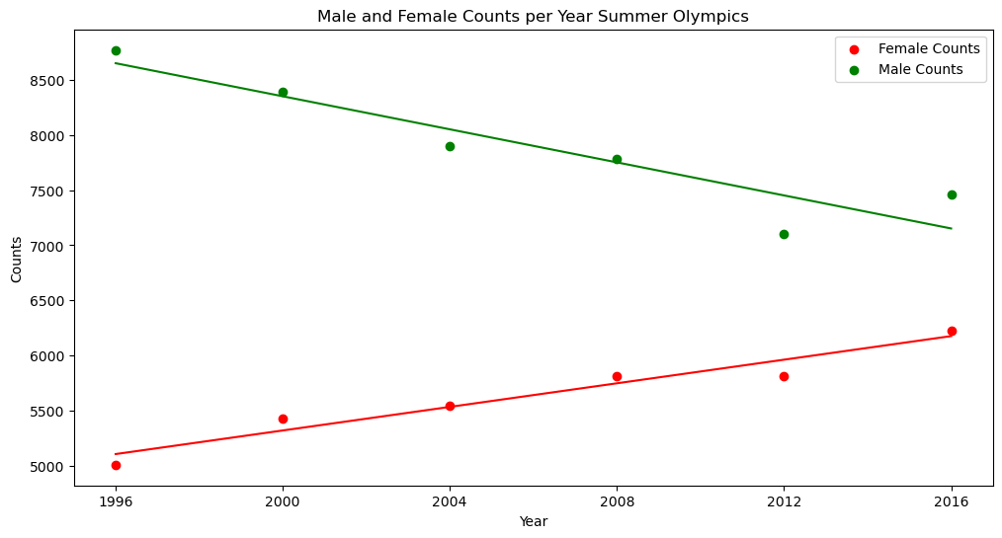
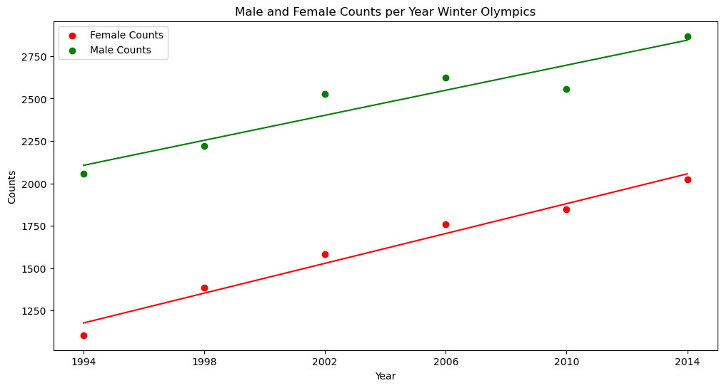


Separate the Summer and Winter Olympiads: Gender Split

Slide 5
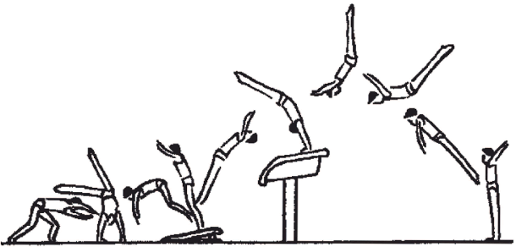
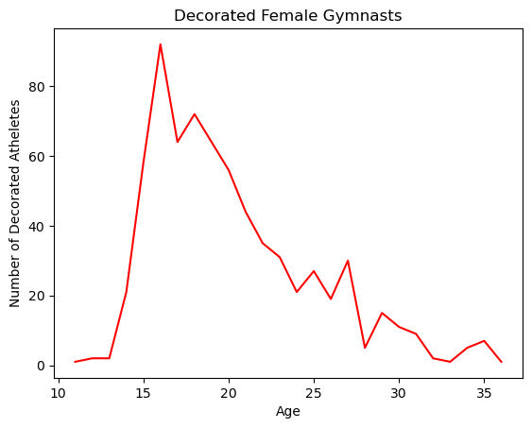

Age and Medalist Correlation in Women’s Gymnasts

Slide 6
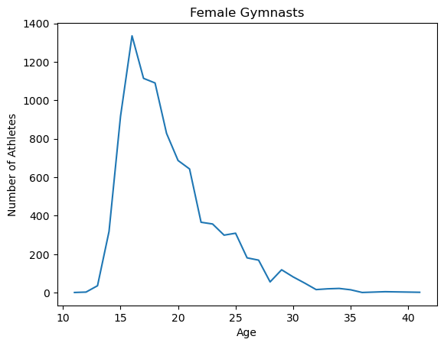
Age and Medalist Correlation in Women’s Gymnasts

Slide 7
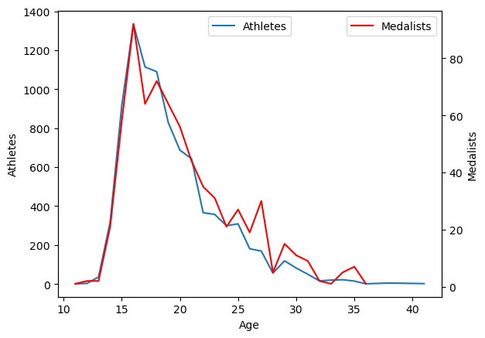
Age and Medalist Correlation in Women’s Gymnasts

Slide 8
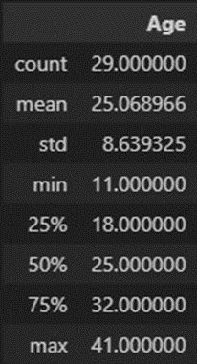
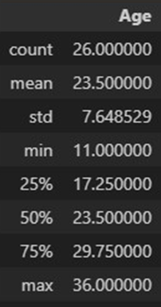
Age and Medalist Correlation in Women’s Gymnasts

Slide 9
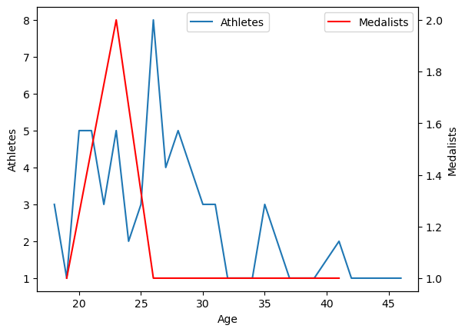
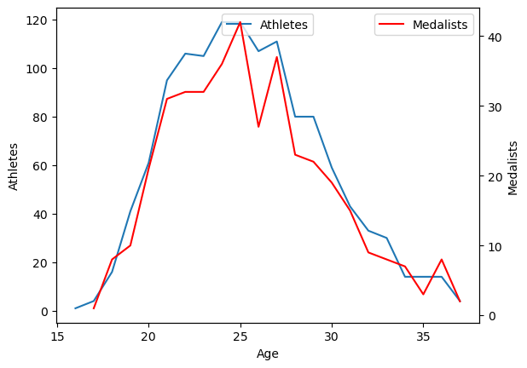
Age and Medalist Correlation in Other Female Sports

Slide 10
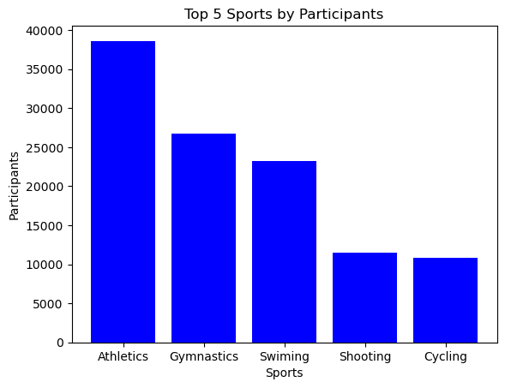
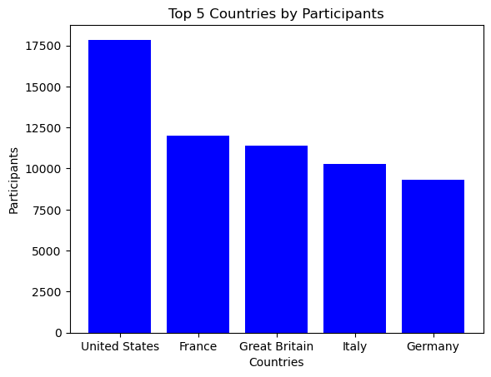
Olympic Games Overview

Slide 11
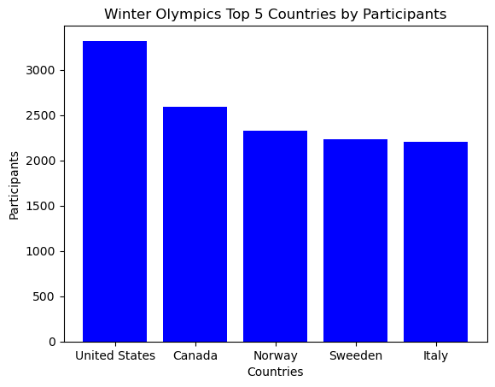
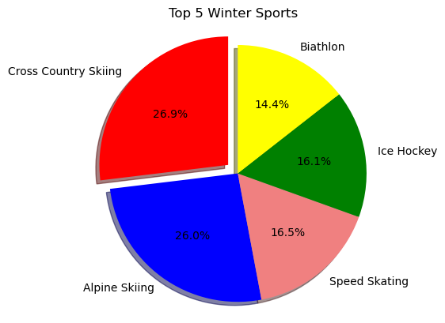
Winter Olympics

Slide 12

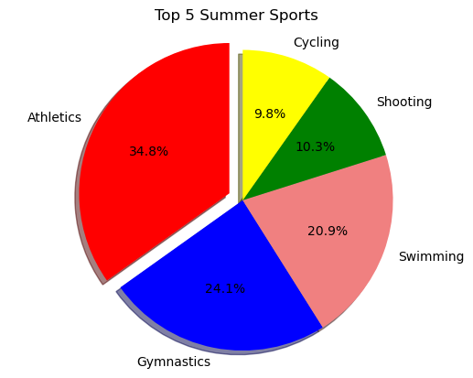
Summer Olympics

Slide 13
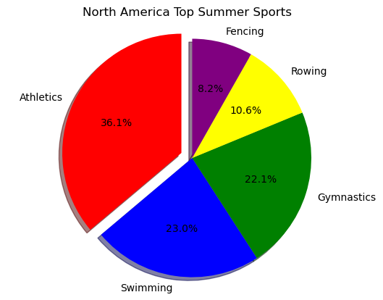
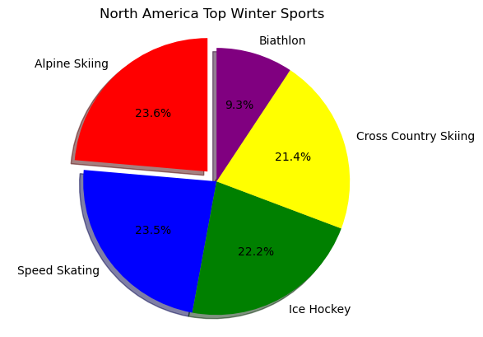
North America

Slide 14
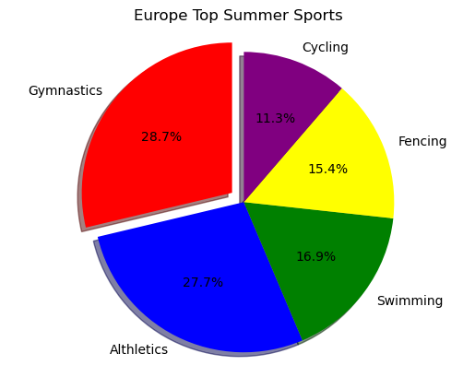
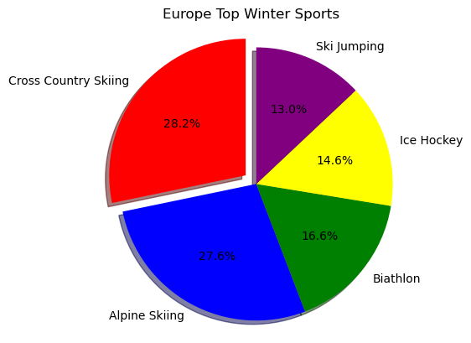
Europe

Slide 15
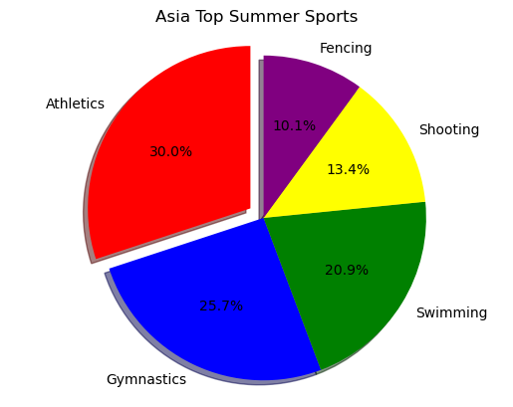
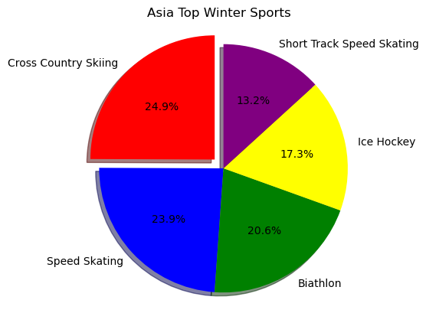
Asia

Slide 16
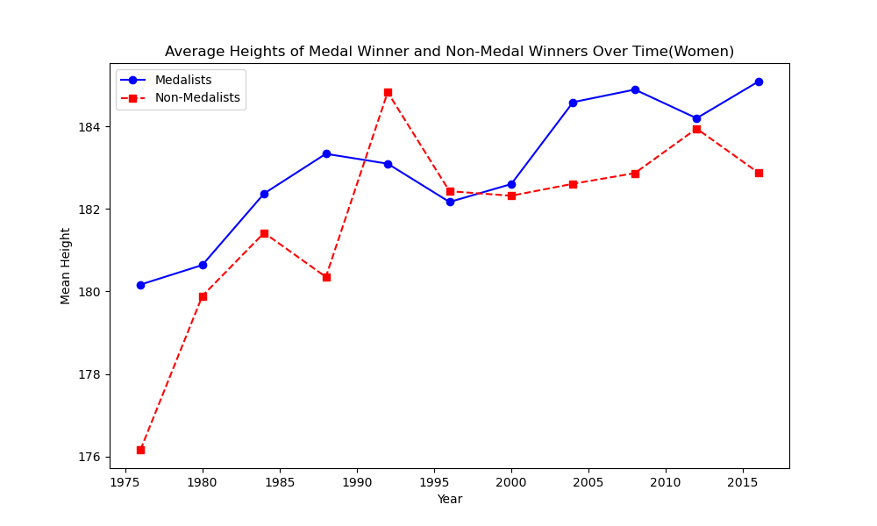
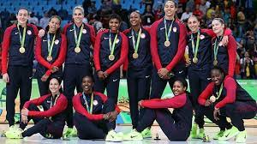
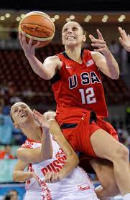

Average Height of Medalist vs Non-Medalist (Women)
T Test Result:
Statistic=1.2910745454235144,
P - value=0.19711525992599624

Slide 17
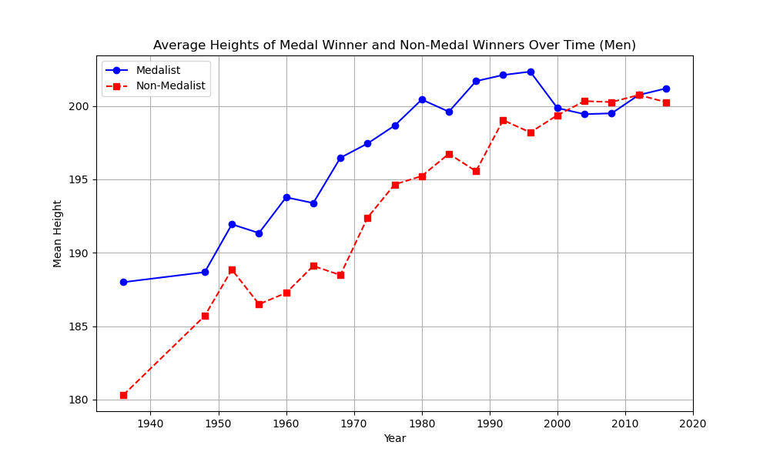
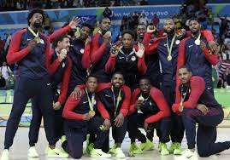
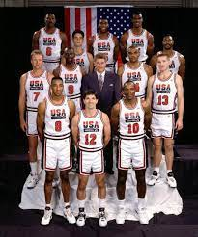
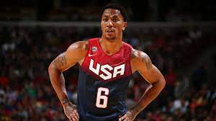
Average Height of Medalist vs Non-Medalist (Men)
T Test Result:
Statistic=7.283799718776104,
P - value=6.211224212140947e-13

Slide 18
Thank you!

